Slide 1

Game Design Fundamentals
Crafting Meaningful Interactive Experiences

Slide 2
What’s in a Game?
Games have a few primary features. They…
Are a form of play (intrinsic: pleasure / enjoyment)
Have a set of rules the provide structure for the play
Involve some form of conflict (with others and/or environment)
Have one or more goals the player seeks to attain
Games are distinct from other activities we engage in:
Work (extrinsic: money / power)
Toys (freeform - no goals / rules / conflict)
Puzzles* (no rules / conflict)
Some argue that Minecraft and Terraria are game platforms (not ‘merely’ games).

Slide 3
Video Game Design Elements
A few major elements are present in most modern games:
What is needed to play (technology)
Rules / abilities / structure (mechanics)
The way that the game unfolds in play (story)
How the game looks / sounds / feels (aesthetics)
Experience
story
aesthetics
More Visible
Less Visible
Function
technology
mechanics
Context
Interaction
Each interacts with the others to construct the player’s experience.

Slide 4





Technology
Technology includes all of the materials we need for the game:
Hardware (game console, controllers)
Software (game libraries / engines)
Physical props (game cards, ‘golf club’ mounts, etc)
Technology can introduce novel features and can facilitate other elements, but can also limit them.

Slide 5
Mechanics
The mechanics determine the structure of the game:
Establish rules (abilities, limitations, requirements, prohibitions)
Define goals (objectives, win/loss conditions)
Dictate progression (layout of experience / flow)
Structure interaction with the game state
Example: Pac-Man
Rules
If player touches a non-vulnerable ghost, lose a life
If lives is zero, game is over
If player eats a power pellet, all ghosts become vulnerable
If all pellets have been eaten, go to next level
Goals
Get high score
Eat ghosts
Eat fruit
Clear levels
Progression
Levels / cut scenes
Interaction
Move up/down/left/right
Mechanics intimately connect to player decisions & are constantly evolving!

Slide 6
Mechanics
Commonly, mechanics fall into these categories:
Spaces where the game takes place and their boundaries
Objects that have state (and often behavior)
Actions that change the game state
Rules that define the spaces, objects, actions, and goals
Skills that players must learn and/or master to progress
Chance constructs that introduce uncertainty
Check out three-hundred mechanics here: http://www.squidi.net/three/
Notes:
(2D/3D; Maps/Levels)

Slide 7
Story
The story is the sequence of events that unfold in a game:
May or may not be narrative (e.g., Cookie-Clicker)
Should connect to gameplay mechanics & overall theme
Can have linear, branching, and parallel path (merging) storylines
Linear
Branching
Parallel Path
(PacMan)
(Phantasy Star III)
(Hero’s Quest)

Slide 8
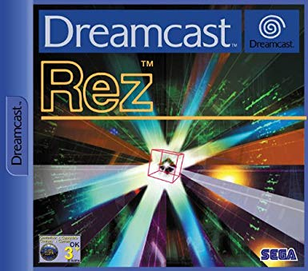

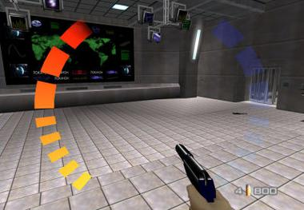
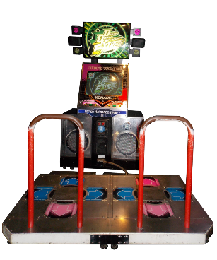

Aesthetics
Communication with the senses defines the aesthetics of a game:
Creates a sense of immersion in the game
Contributes and connects to story and mechanics
Depends on technology available (video, audio, haptic feedback)
Can paper-over design… challenges
Remember: aesthetics isn’t just the visuals – the other senses matter too!

Slide 9
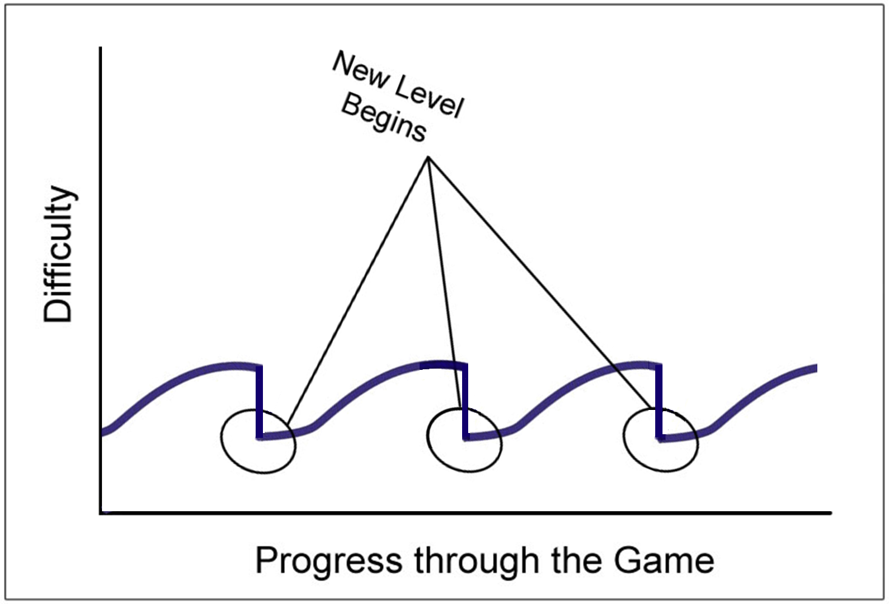
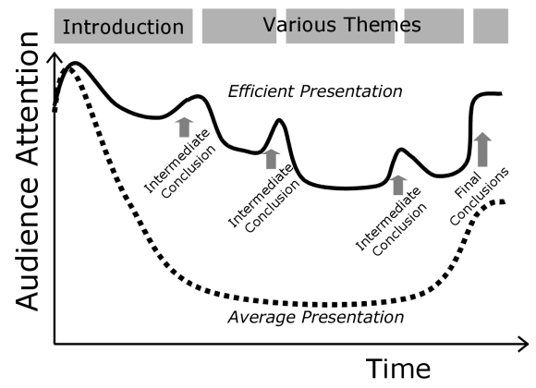
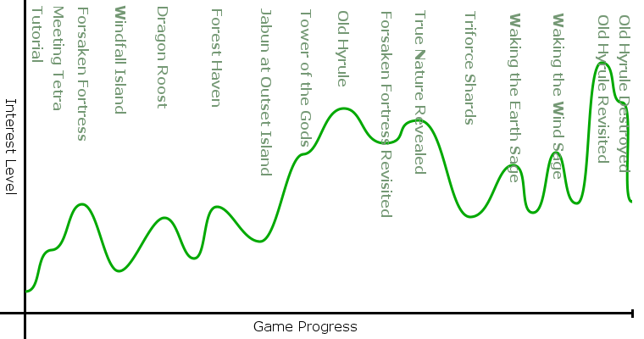
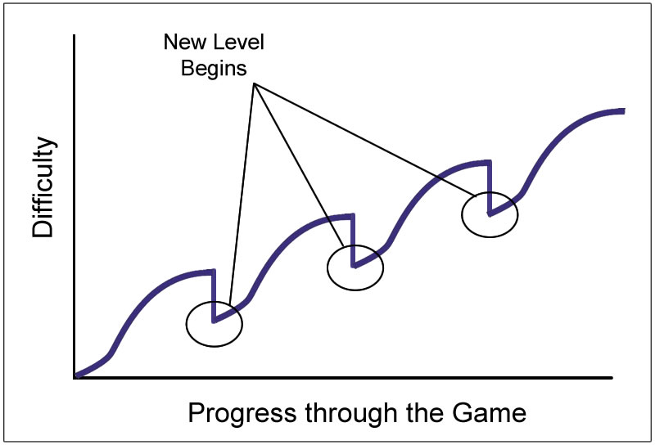
Managing Engagement & Interest
Consider of player engagement at stages in the game is key.
We can’t be 100% engaged 100% of the time – comes in waves!
Directly related to difficulty curves (see: Nishikado Motion)
Careful with difficulty: interest and difficulty aren’t one-to-one!
Composite games give us a mechanism to vary play type
play type
Attention Curves (Syncat Academy)
The Legend of Zelda: the Wind Waker (B. C. Buchanan)
Nishikado Motion (P. Holleman)
Notes:
(interest/attention/arousal curves)

Slide 10
References
J. Schell. 2008. The Art of Game Design: A Book of Lenses. CRC Press.
Syncat Scientific Leadership. How to Give Successful Oral Presentations. http://www.scientificleaders.com/presentations
Game studies Wiki. Interest Curve. http://game-studies.wikia.com/wiki/Interest_Curve

